Slide 1

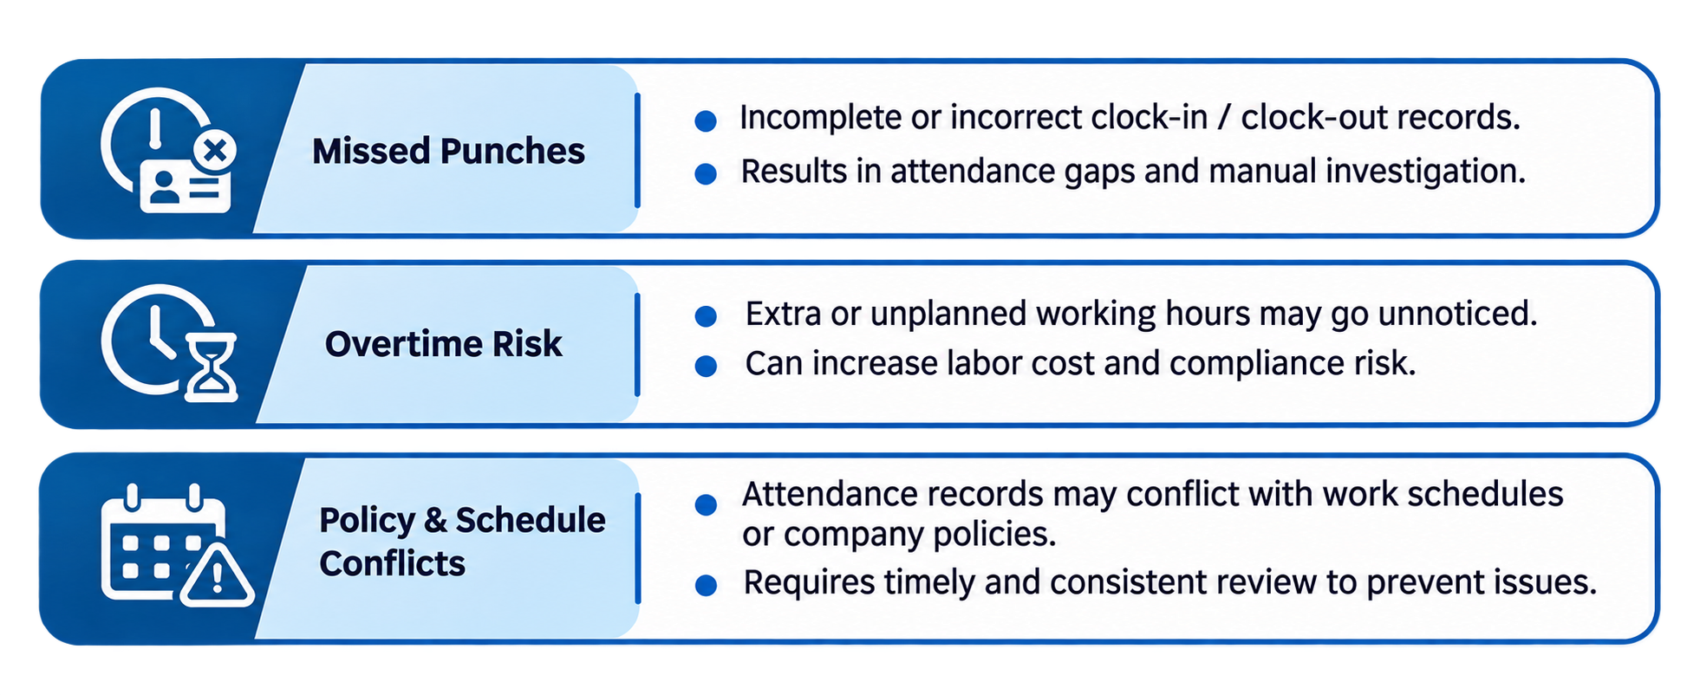
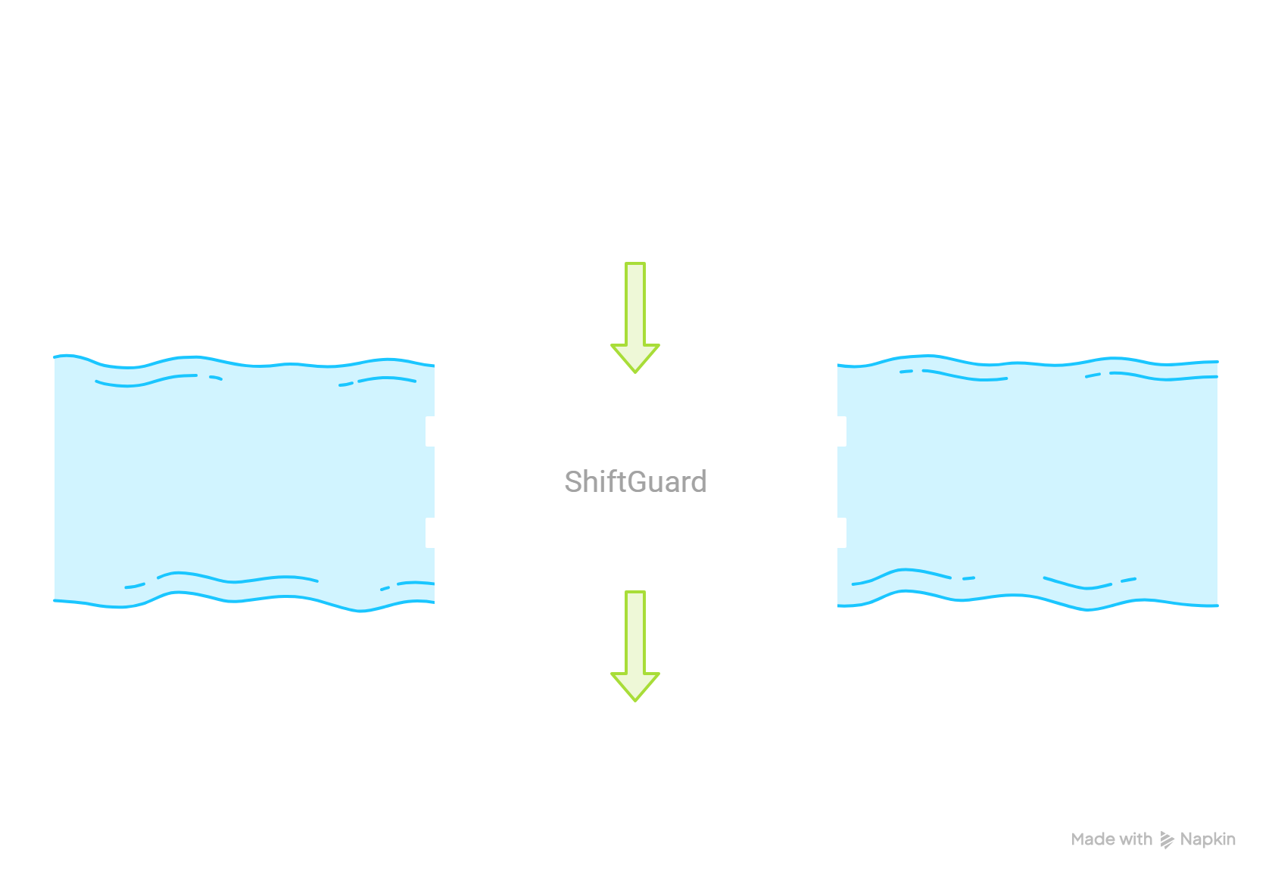
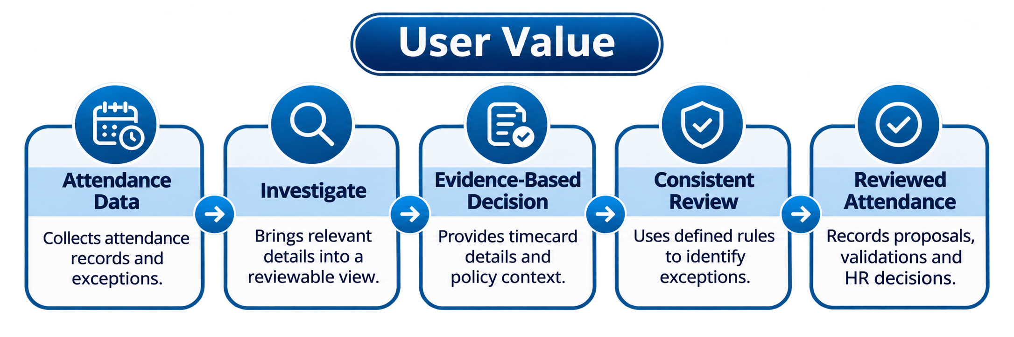
DAYFORCE AI INNOVATION CHALLENGE
THE CHALLENGE
Managing employee attendance involves several records, rules and policies. Small discrepancies can create operational and compliance challenges.
ShiftGuard
Time & Attendance Agent

Slide 2
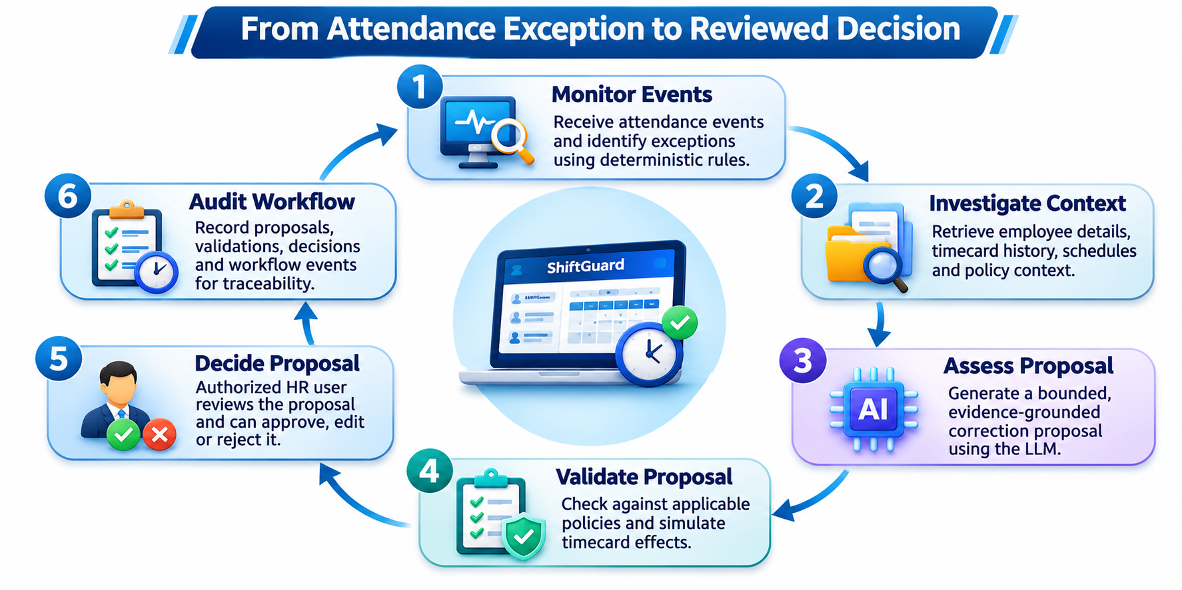
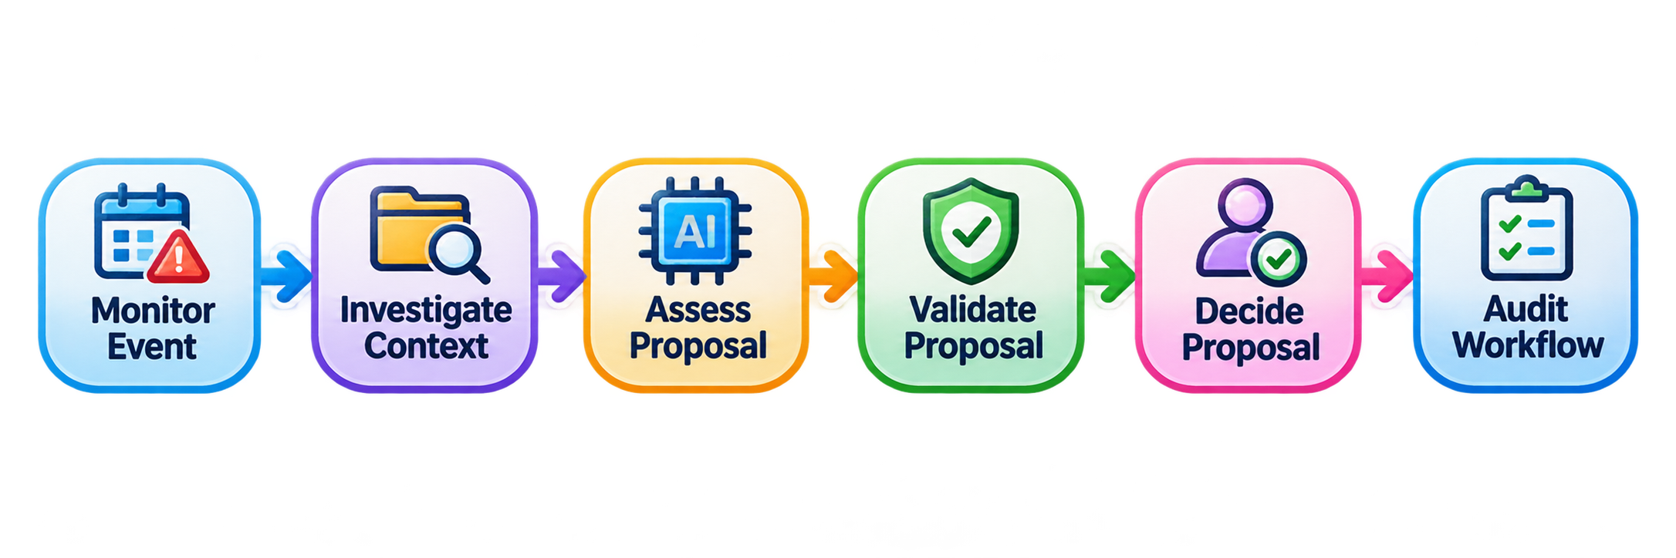
PRODUCT WORKFLOW
02 / 05
DEMONSTRATION :
SHIFTGUARD | TIME & ATTENDANCE

Slide 3
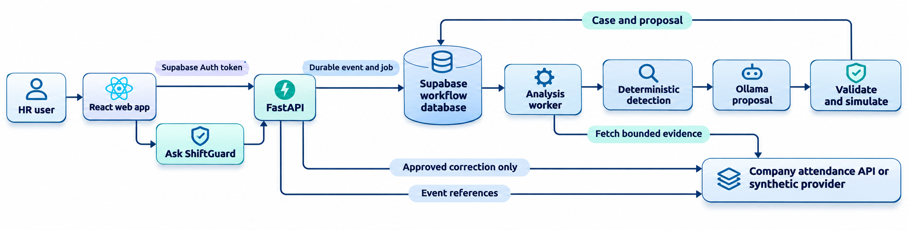
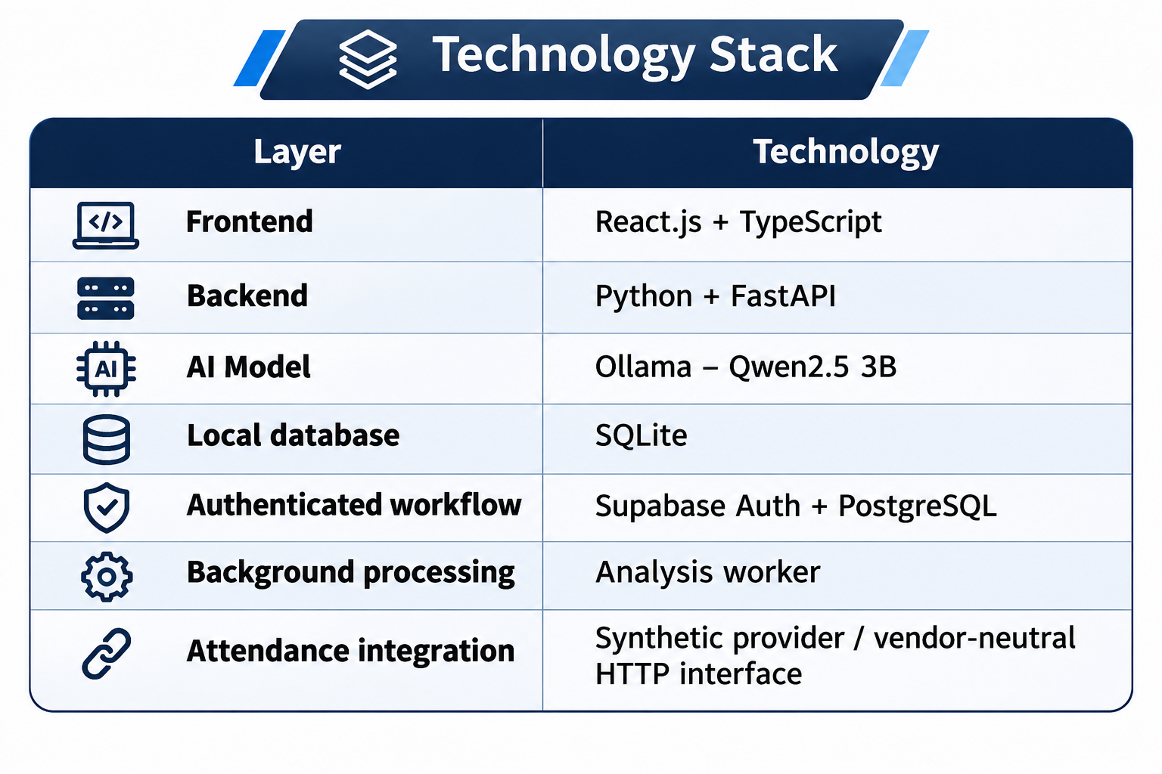
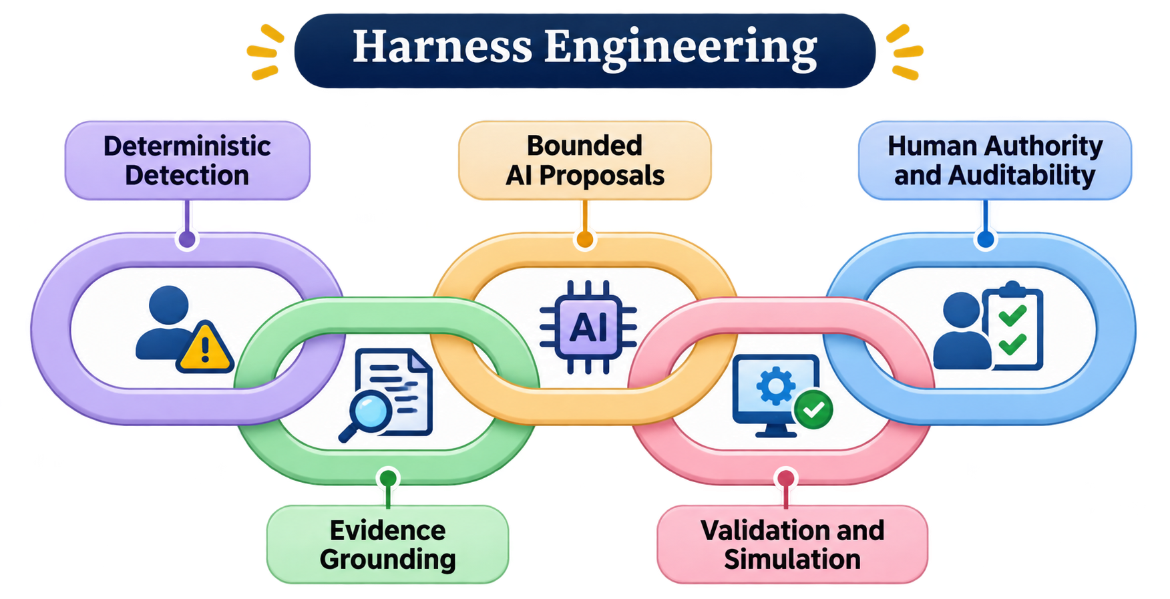
ARCHITECTURE & HARNESS DESIGN
03 / 05

Slide 4
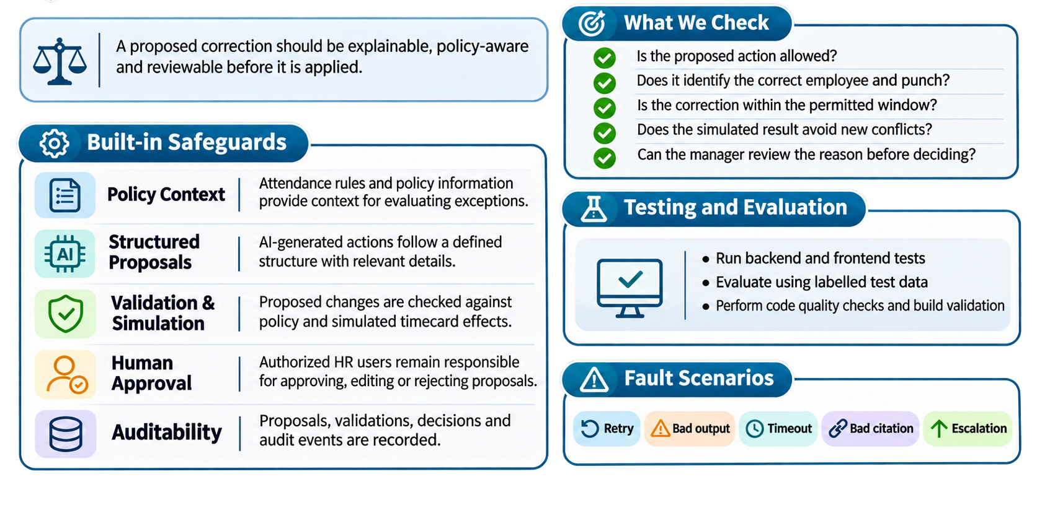
SAFETY TESTING & EVALUATION
04 / 05

Slide 5
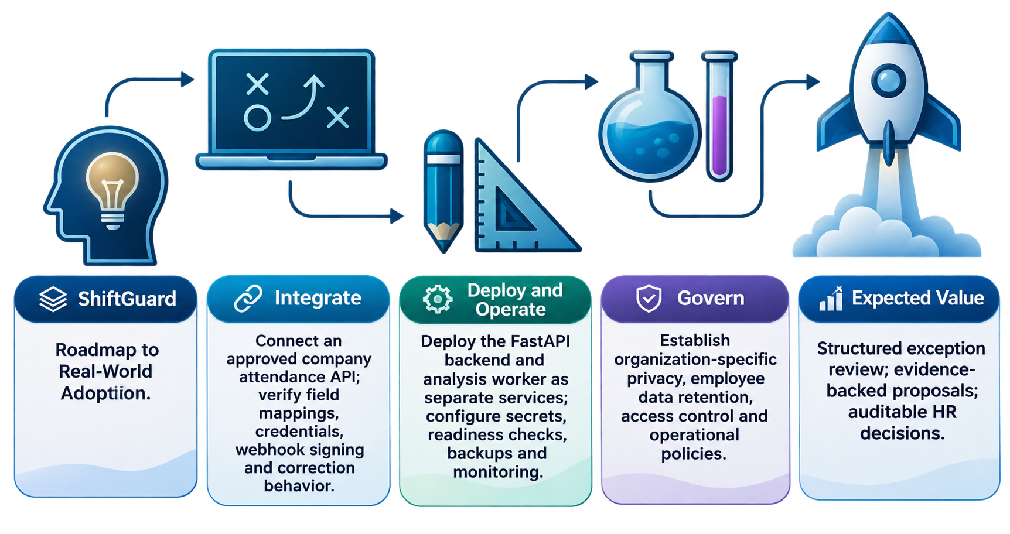
FUTURE IMPROVEMENTS & BUSINESS IMPACT
05 / 05
EXPECTED VALUE
Less manual investigation • More consistent reviews • Earlier visibility into attendance risks

